Slide 1
Substation and Distribution Automation
Module 9: Automated Switching and Reconfiguration

Slide 2
Module 9 Overview
Part 1: Switching and protective devices
Part 2: Protection schemes
Part 3: Reconfiguration
Part 4: Switching examples

Slide 3
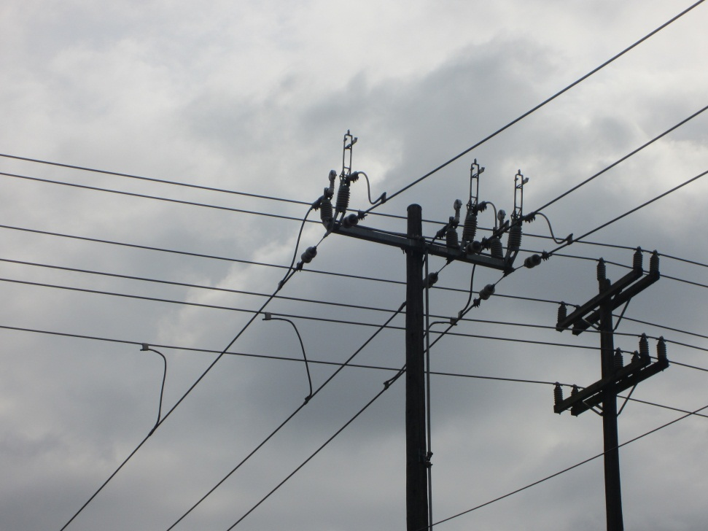
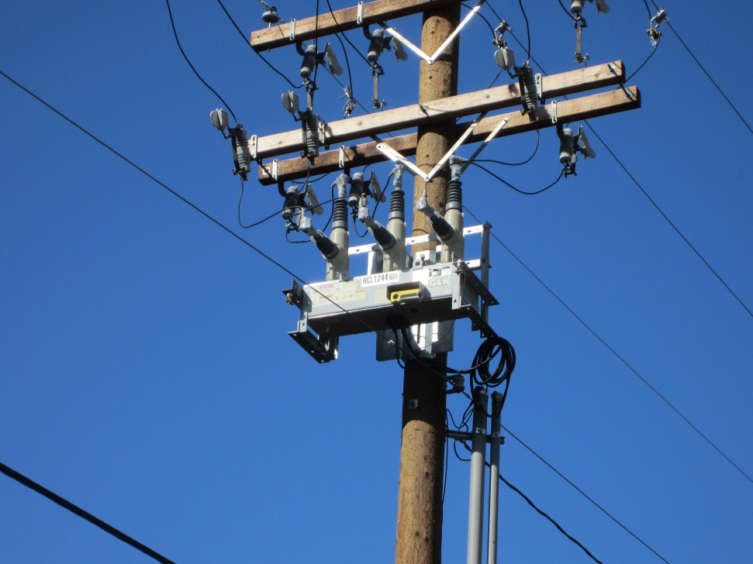
Part 1: Switching and Protective Devices

Slide 4
Switching and Protective Devices
Switches
Circuit Breakers
Fuses
Reclosers
Sectionalizers

Slide 5
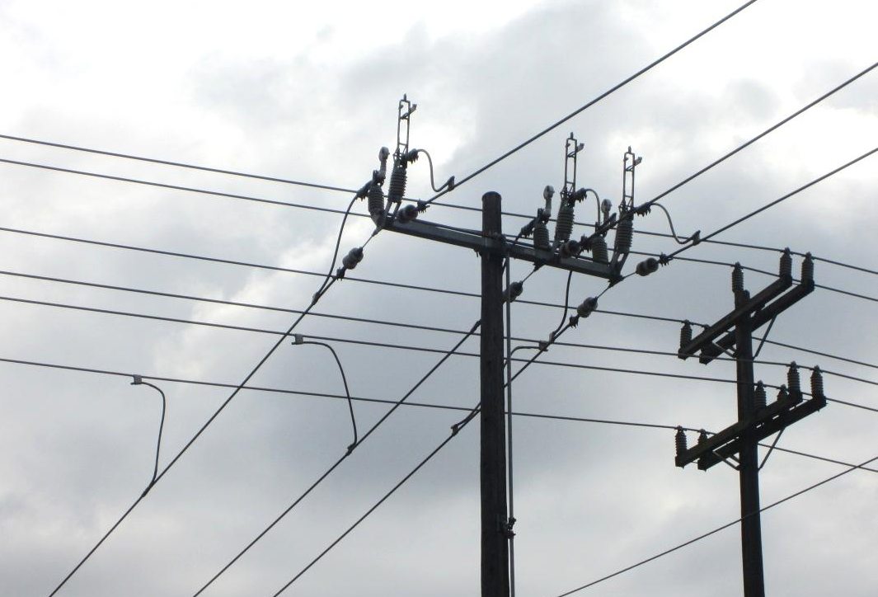
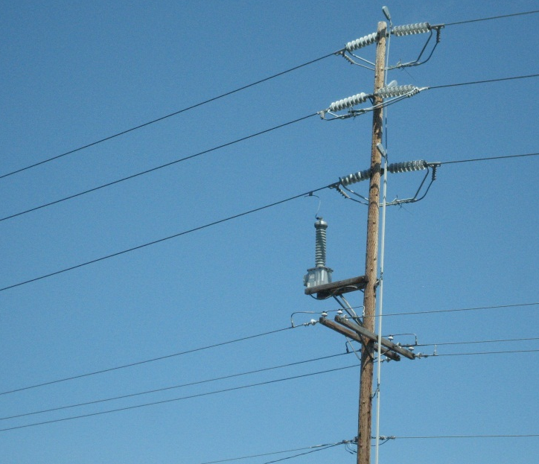
Switches
Switches are simple devices that typically do not have any controls or communication.
A switch can not break fault current.

Slide 6
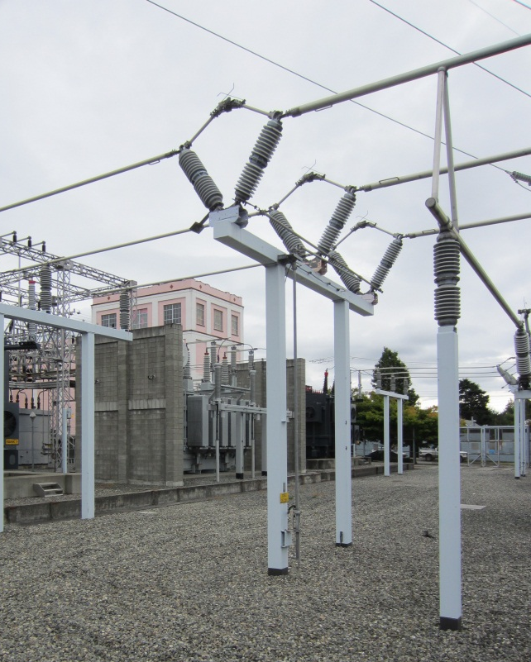
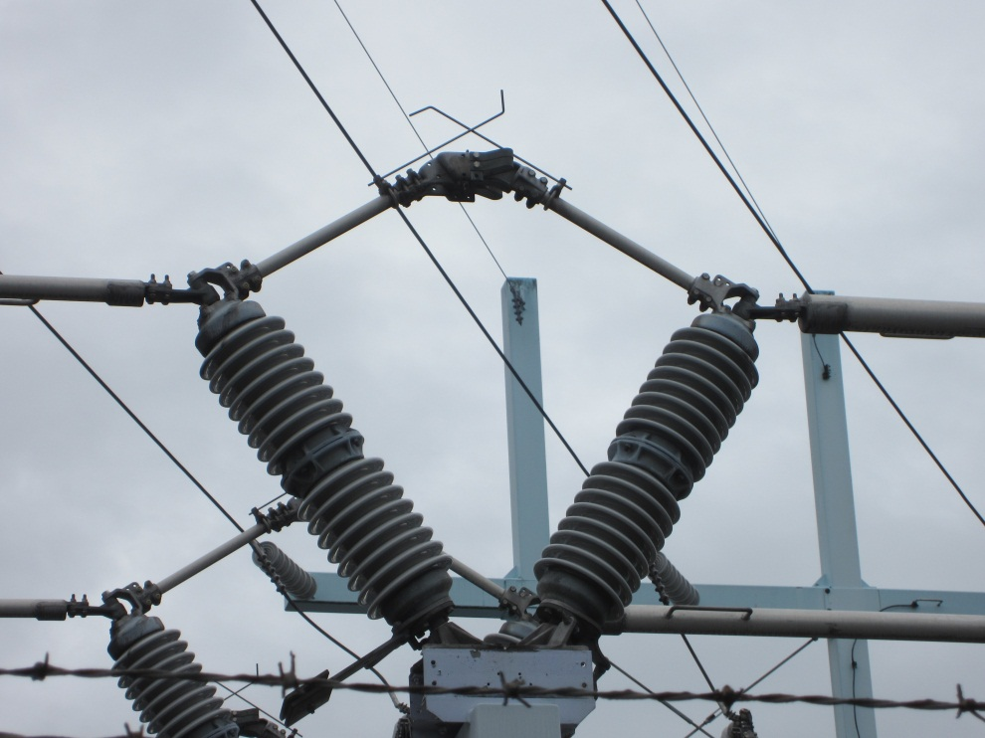
Switches
Used to:
Disconnect portions of a feeder or equipment
Reconfigure the feeder
Bypass portions of a feeder or equipment
Portions of the feeder or equipment may be disconnected and taken out of service for maintenance or repair.

Slide 7
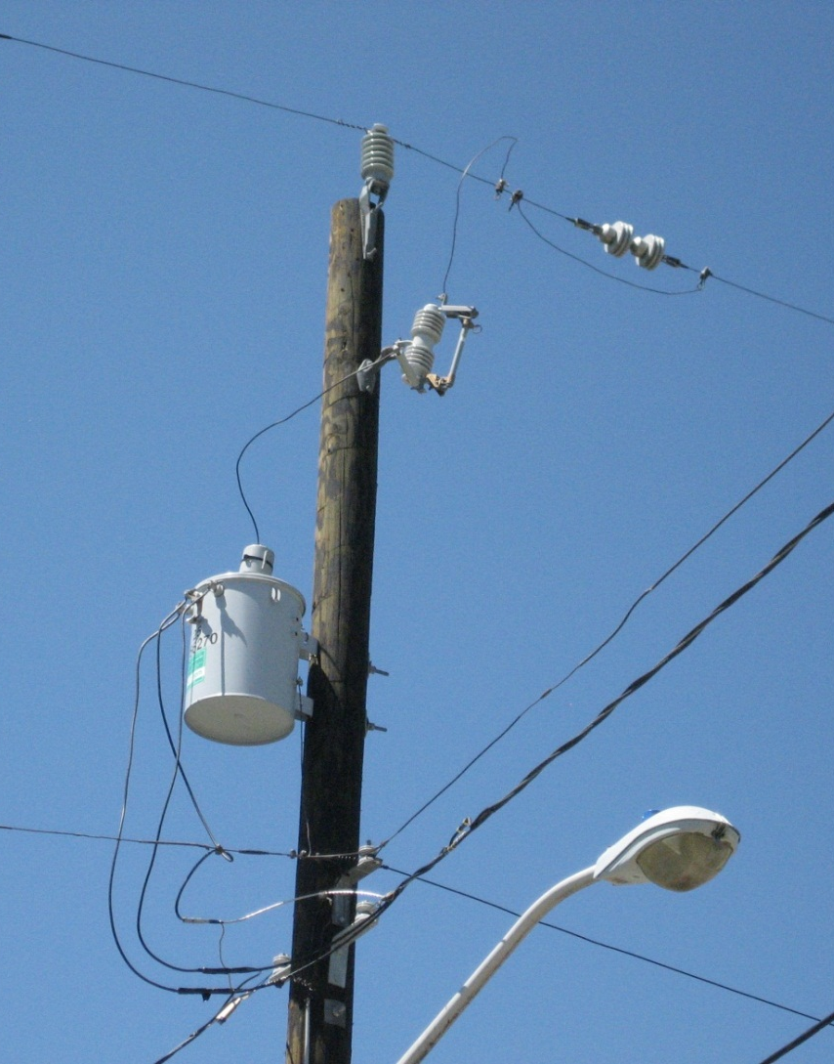
Fuses
Protection device used to break fault current.
Removes faulted sections of a feeder from the system.
Need to be manually replaced because the fuse sacrifices itself to protect the feeder and its components.
Fuse designed to ‘blow’ within specified time for given value of fault current.
Types of fuses?– distribution cut-outs, power fuses

Slide 8
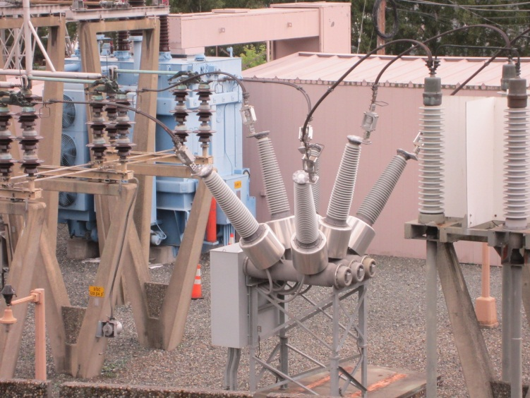
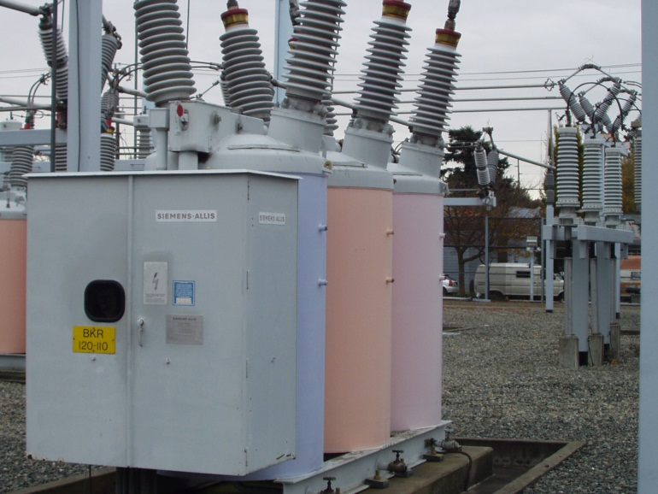
Circuit Breakers
Similar to switches, but have the ability to break fault current and work autonomously.
Do not need to be replaced like fuses and can generally be reset/closed.
Typically used for protection rather than a simple disconnect.
Older models don’t have communications or complex controls.

Slide 9
Circuit Breakers (Continued)
Newer models have the option to have communications and more complex controls.
Given the ability to control remotely and provide feedback to the control center, circuit breakers are becoming more prevalent for feeder reconfiguration and as bypass components.

Slide 10
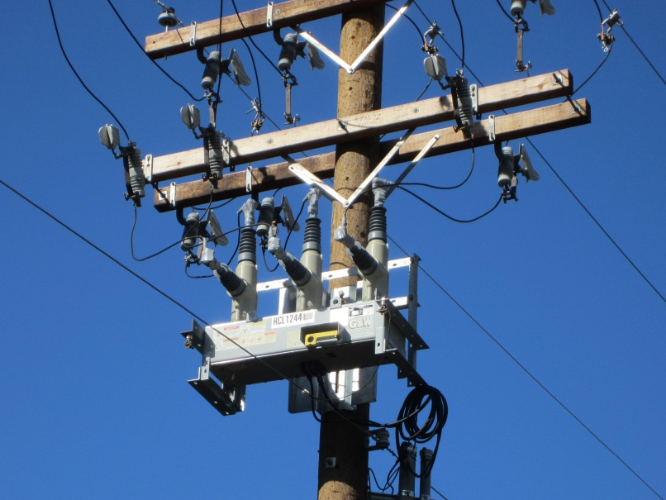
Reclosers
Similar to circuit breakers, but with more complex controls and the option for even more measurement and feedback.
Used for protection, especially for fault detection and disconnection.
Trips and recloses to clear temporary faults
The number of tries to reconnect is user configurable, but is typically set for three attempts.

Slide 11
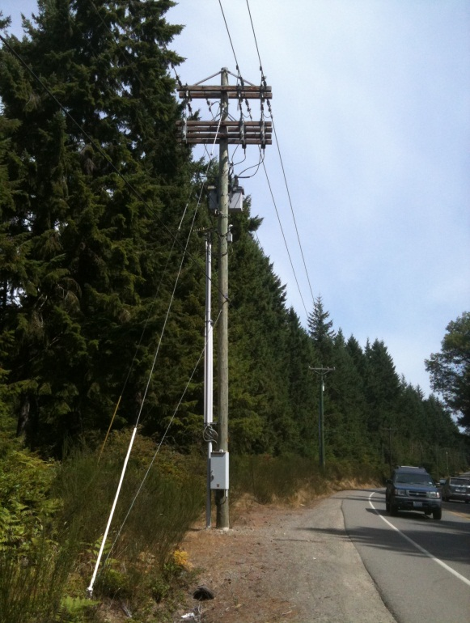
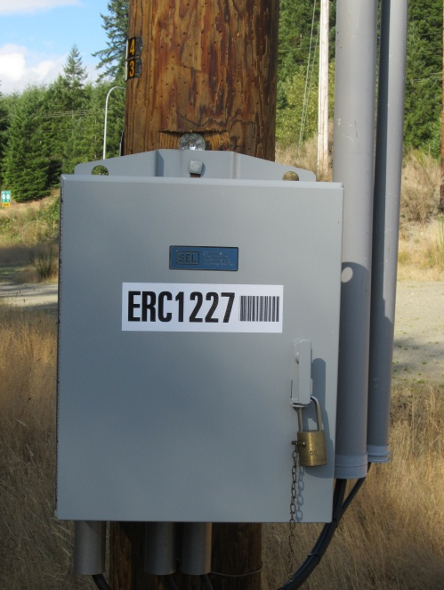
Reclosers (Continued)
With the development of the Smart Grid, reclosers are starting to incorporate more advanced metering and reporting capabilities.

Slide 12
Sectionalizers
Similar to circuit breakers, but can not break fault current and have more complex controls.
Used in conjunction with a recloser.
The recloser breaks the fault current, the sectionalizer disconnects the faulted section from the feeder and the recloser reconnects the rest of the feeder to power.
With the development of the Smart Grid, sectionalizers are starting to incorporate more advanced metering and reporting capabilities.

Slide 13
Part 2: Protection Schemes
The individual protection devices in the previous section can be combined into various protection schemes.
When the power flow is radial then the schemes are relatively simple, but bidirectional power flows can complicate protection schemes.

Slide 14
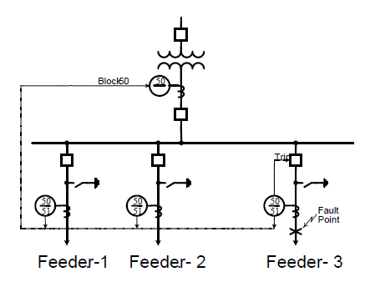
Overcurrent
Most common protection scheme in distribution substations is over current protection for prevention against feeder faults.
The figure shows the co-ordination between different instantaneous tripping elements in the substation.

Slide 15
Bus Differential
…

Slide 16
Transformer Differential
…

Slide 17
Zone Protection
…

Slide 18
Part 3: Reconfiguration

Slide 19
Part 4: Switching Examples

Slide 20
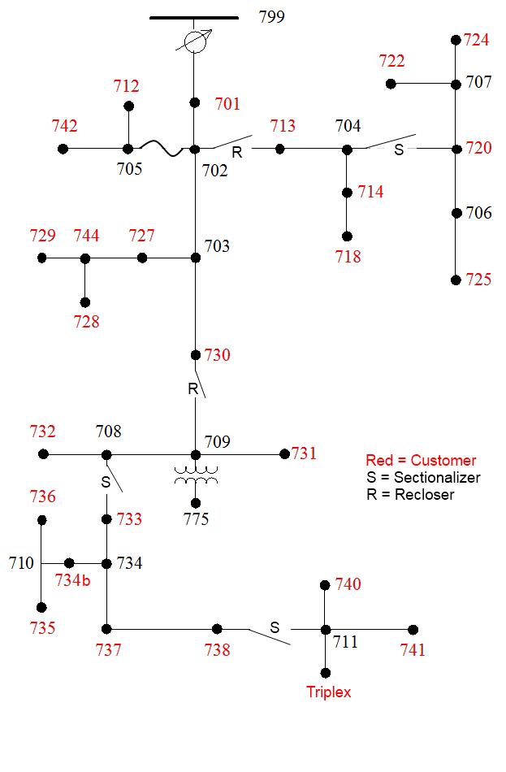
Example Scenario 1
Fault on line 711-741
The recloser between nodes 730 and 709 opens.
The sectionalizer between nodes 738 and 711 opens and disconnects the fault.
The sectionalizer between nodes 708 and 733 remains closed as it delays long enough to let the downstream sectionalizer open first.
The recloser closes and the fault is disconnected from the system.
IEEE 37 Node

Slide 21
Example Scenario 2
Fault on line 710-735
The recloser between nodes 730 and 709 opens.
The sectionalizer between nodes 708 and 733 remains closed as it delays long enough to let the downstream sectionalizer open first.
The sectionalizer between nodes 738 and 711 does not open as it does not sense fault current.
The recloser closes, but there is still a fault and opens again.
The sectionalizer between nodes 708 and 733 opens and disconnects the fault.
The recloser closes and the fault is disconnected from the system.
IEEE 37 Node

Slide 22
Example Scenario 3
Fault on line 775-709
Assume no protection on the transformer.
The recloser between nodes 730 and 709 opens.
The recloser closes, but there is still a fault and opens again.
The recloser closes, but there is still a fault and opens again.
The recloser closes, but there is still a fault and stays open. The recloser has now disconnected the fault from the system.
IEEE 37 Node

Slide 23
Example Scenario 4
Fault on line 705-712
The fuse between nodes 702 and 705 blows and removes the fault from the system.
IEEE 37 Node

Slide 24
Example Scenario Solutions
For Example Scenarios 1-3, a crew is dispatched to clear the fault.
The protective devices are reset either remotely or locally.
In Example Scenario 4, a crew is dispatched to clear the fault
The fuse is replaced.

Slide 25
Module 9 Concluding Comments
1
2
3
4

